Slide 1
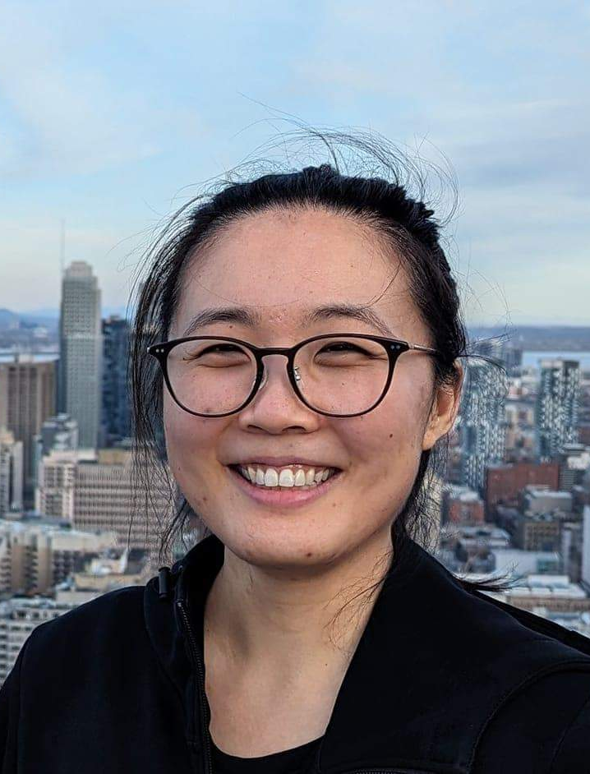
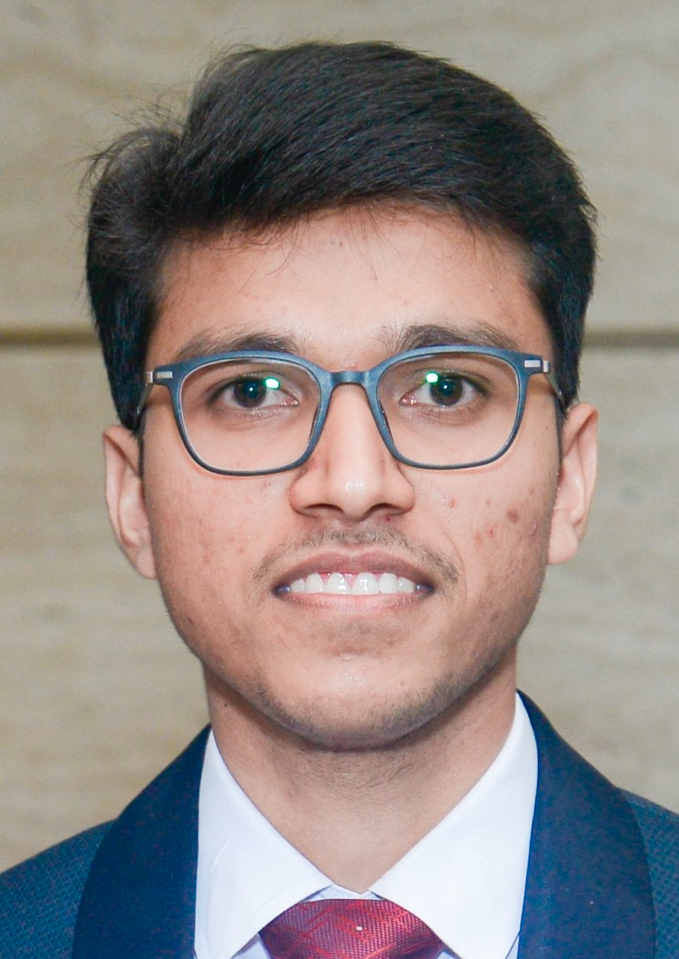
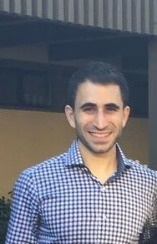
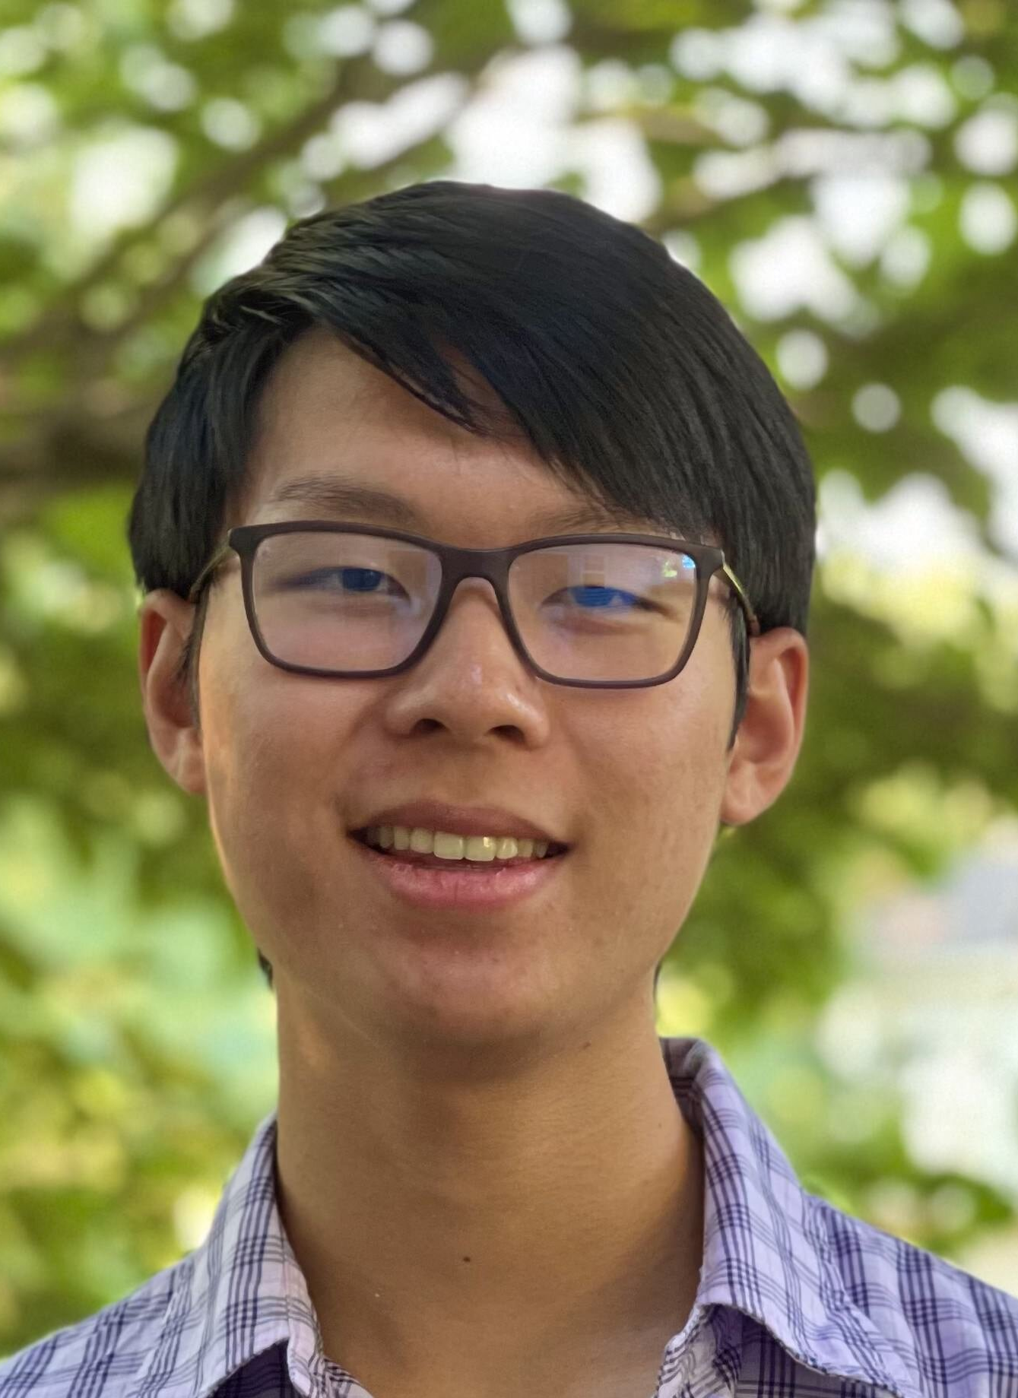
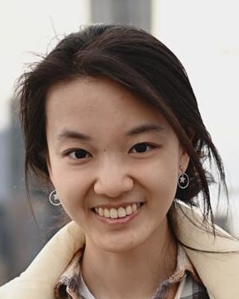
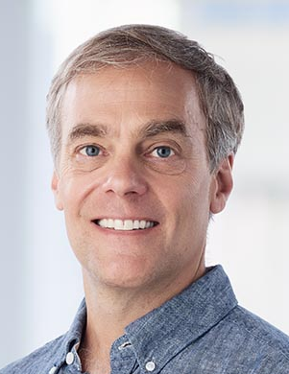
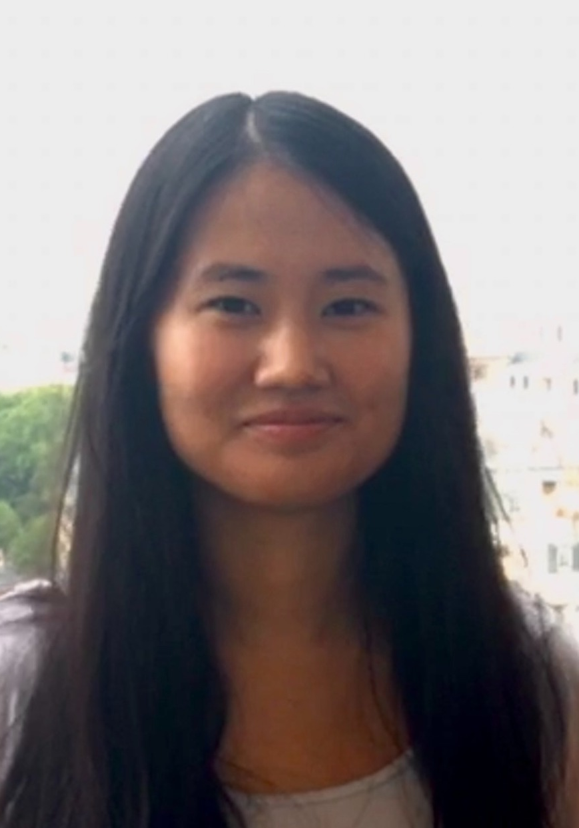
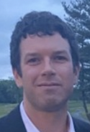
A new primitive for uncertainty quantification
Hong Namkoong, Oct 2026
Tiffany Cai
Daksh Mittal
Dan Russo
Jimmy Wang
Naimeng Ye
Rich Zemel
Kelly Zhang
Tom Zollo

Slide 2
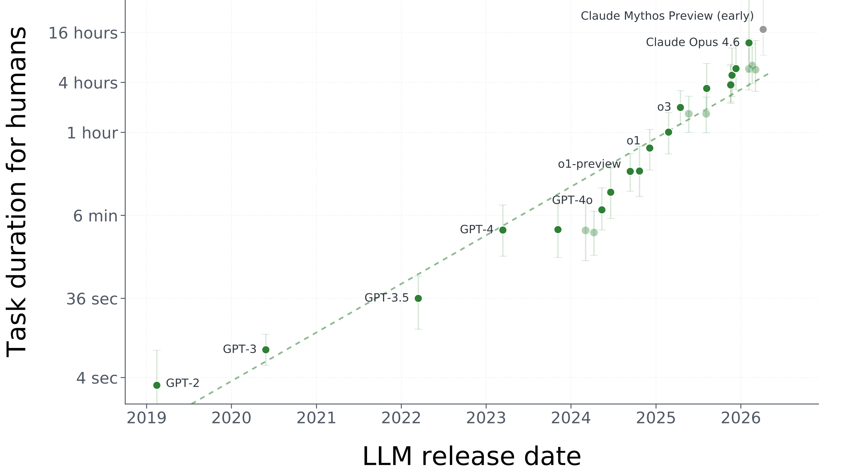

Progress in AI

Slide 3
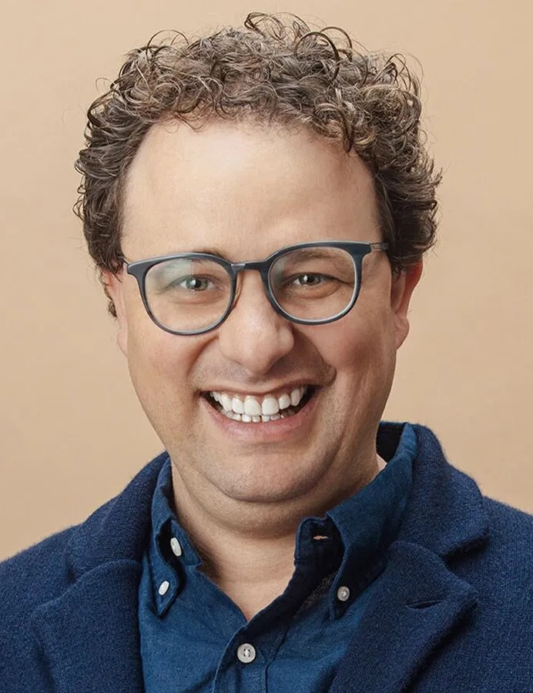
Progress in AI
In 1-5 years, AI could wipe out half of all entry-level
white-collar jobs
Future ?

Slide 4


Learning from experience
Progress driven by scaling knowledge distillation
But long-horizon tasks are underspecified
AI must reflect on what it doesn’t know and act to resolve future uncertainty
ChatGPT
MBAs
Repository of humanity’s discoveries, but doesn’t get better by themselves
Know virtually nothing, yet they become competent professionals after working in the real world for 5 years

Slide 5
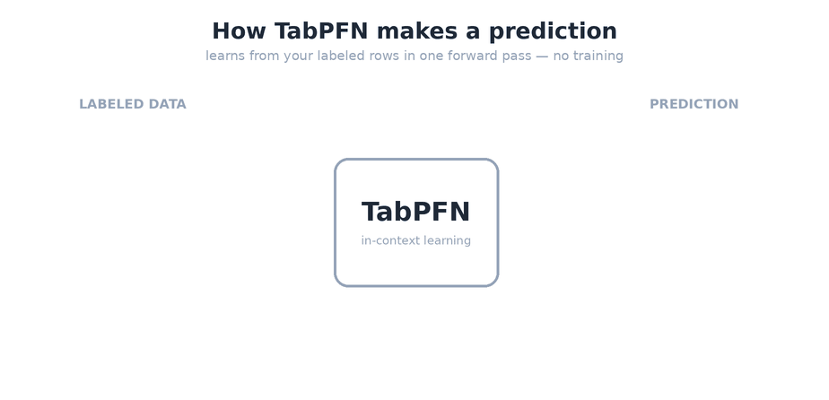
Progress in AI
30% of patients develop atrial fibrillation after open heart surgery
Risk score can allow surgeons to intervene, e.g., clip atrial appendage
Approach 1: Standard ML
Work hard to train a fancy model & carefully tune it
Approach 2: Lazy prompting
Prompt a pre-trained transformer with your data and x, ask it to predict y
Hollman et al. ‘25

Slide 6
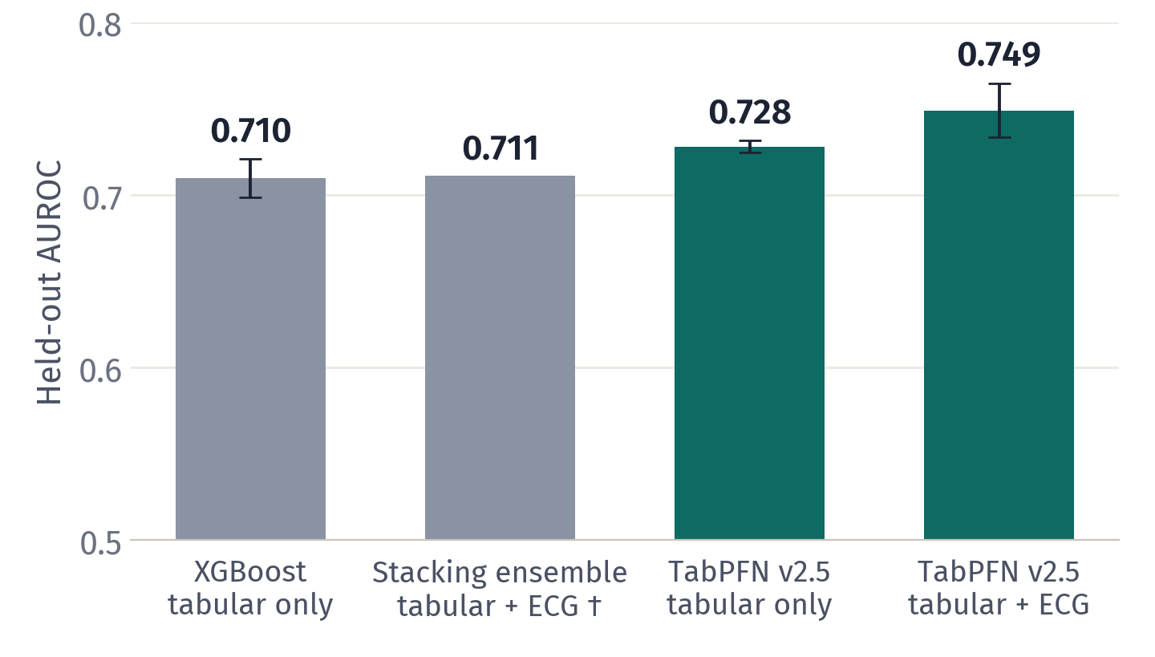
Progress in AI
30% of patients develop atrial fibrillation after open heart surgery
Risk score can allow surgeons to intervene, e.g., clip atrial appendage
Approach 1: Standard ML
Work hard to train a fancy model & carefully tune it
Approach 2: Lazy prompting
Prompt a pre-trained transformer with your data and x, ask it to predict y

Slide 7
Progress in AI
30% of patients develop atrial fibrillation after open heart surgery
Risk score can allow surgeons to intervene, e.g., clip atrial appendage
  Premise of this talk: AI can i) seamlessly integrate data modalities
  ii) transport well under distribution shift
Approach 1: Standard ML
Work hard to train a fancy model & carefully tune it
Approach 2: Lazy prompting
Prompt a pre-trained transformer with your data and x, ask it to predict y

Slide 8
Knowing what you don’t know
Several lines of work tackle uncertainty quantification
  Bayesian neural networks, GPs, ensembles, epistemic neural nets, conformal prediction, multi-calibration…many other interesting ideas
But these ideas have not “scaled” to the level of LLMs

Slide 9
Knowing what you don’t know
Several lines of work tackle uncertainty quantification
  Bayesian neural networks, GPs, ensembles, epistemic neural nets, conformal prediction, multi-calibration…many other interesting ideas
But these ideas have not “scaled” to the level of LLMs
Why? The bitter lesson: only thing that works is scaling up training data by
  optimizing loss on web-scale training data
  testing engineering innovations based on val loss

Slide 10
Example: adaptive student assessment
Why probabilistic modeling is hard
X’s exogenous & plentiful
Z = prior info
$X_{1}=$A juice bottle has 3.9 liters. If I share it equally among 13 friends how many liters does each get?”
$X_{2}=$If 13 aunts each give Timmy $0.75 for Christmas, how much does he have?
Amin generally solves single-digit division problems fluently and uses repeated subtraction when working with larger numbers. When asked to explain his reasoning, he often relies on ‘what feels right’ rather than written strategies. He’s more confident when problems are framed in real-life contexts, like sharing food or money, and shows persistence even when confused.
$Y_{1}=$I divided 3.9 by 13 and got 3, so I think each friend gets 3 liters. Answer: D
$Y_{2}=$I multiply 13 × 0.75 and get $9.75 total. Answer: B
Amin
Which questions X will Amin struggle with?

Slide 11
Example: adaptive student assessment
Why probabilistic modeling is hard
For “environment $Z$ ”, we observe $Y_{t}=f^{⋆}(X_{t})+ε_{t}$ for t=1,…,10
Goal of probabilistic inference: posterior distribution over $f^{⋆}(⋅)$
But how do we draw a good confidence interval around a function whose values are never observed?
Why typical ML is useless here
Hard to fit Y|X with a few samples
This only gives you a single $\overset{̂}{f}(x)$
Unclear how to leverage Z
🤷‍♂️

Slide 12
Example: adaptive student assessment
Why probabilistic modeling is hard
Statisticians have to resort to not using any ML:
This is only easy when $Z∈R^{10}$ and $f^{⋆}(x)=β^{⋆T}x$
Experts spend year(s) comping up with a reasonable proxy (“modeling”)
Z = prior info
Amin generally solves single-digit division problems fluently and uses repeated subtraction when working with larger numbers. When asked to explain his reasoning, he often relies on ‘what feels right’ rather than written strategies. He’s more confident when problems are framed in real-life contexts, like sharing food or money, and shows persistence even when confused.
Prior $f^{⋆}(⋅)∼P_{f^{⋆}}(⋅∣Z)$
Likelihood $ε∼P_{ε}(⋅∣Z)$
Amin

Slide 13

Why is this so hard?
Both $f^{⋆}(⋅)$, $ε$ are never observed
How are we supposed to benchmark models if we never see them?
Latent parameter has no physical meaning!
Hard to check whether your unicorn is better than mine

Slide 14
A new primitive for uncertainty quantification
Uncertainty comes from missing data yet to be observed
$P(Y_{t+1:T}∣\underset{⏟}{Z,X_{1:T},Y_{1:t}})$ $=$$∫\overset{T}{\underset{s=t+1}{∏}}\underset{⏟}{P(Y_{s}∣X_{s},f^{⋆},Z)}d\underset{⏟}{P(f^{⋆}|Z,X_{1:t},Y_{1:t})}$

Slide 15
A new primitive for uncertainty quantification
Uncertainty comes from missing data yet to be observed
$P(Y_{t+1:T}∣\underset{⏟}{Z,X_{1:T},Y_{1:t}})$ $=$$∫\overset{T}{\underset{s=t+1}{∏}}\underset{⏟}{P(Y_{s}∣X_{s},f^{⋆},Z)}d\underset{⏟}{P(f^{⋆}|Z,X_{1:t},Y_{1:t})}$
future
past
likelihood (DGP)
prior

Slide 16
A new primitive for uncertainty quantification
Uncertainty comes from missing data yet to be observed
$P(Y_{t+1:T}∣\underset{⏟}{Z,X_{1:T},Y_{1:t}})$ $=$$∫\overset{T}{\underset{s=t+1}{∏}}\underset{⏟}{P(Y_{s}∣X_{s},f^{⋆},Z)}d\underset{⏟}{P(f^{⋆}|Z,X_{1:t},Y_{1:t})}$
future
past
likelihood (DGP)
prior
Classical Bayesians use likelihoods and priors without physical meaning
A predictive view takes one-step predictions as the modeling primitive
$P(Y_{t+1:T}∣Z,X_{1:T},Y_{1:t})$ $=$ $\prod_{s=t}^{T-1}{\underset{one-stepprediction}{\underset{⏟}{P(Y_{s+1}∣Z,X_{1:s+1},Y_{1:s})}}}$

Slide 17




Foundation models
Preliminaries
Observation: we have transformers $\overset{̂}{p}(Y_{t+1}∣Z,X_{1:t+1},Y_{1:t})$ meta-learned across many semi-synthetic datasets
BayesML proposes repeatedly drawing from this distribution
[Muller et al., (’24), Nguyen & Grover (’23)]
Problem: this gives you predictive intervals, but not a distribution over $f^{⋆}(⋅)$! Need to separate out $ε$.

Slide 18
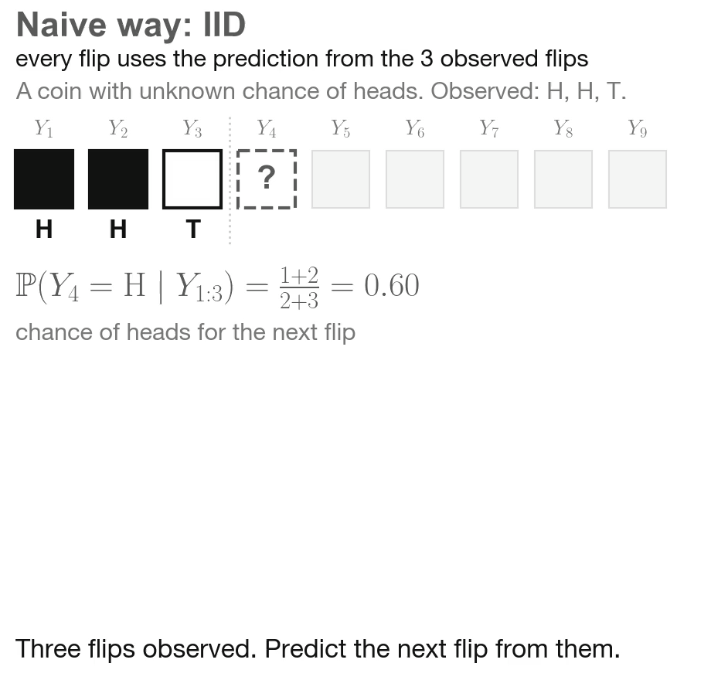
Foundation models
Preliminaries
Observation: we have transformers $\overset{̂}{p}(Y_{t+1}∣Z,X_{1:t+1},Y_{1:t})$ meta-learned across many semi-synthetic datasets
BayesML proposes repeatedly drawing from this distribution
[Muller et al., (’24), Nguyen & Grover (’23)]
Problem: this gives you predictive intervals, but not a distribution over $f^{⋆}(⋅)$! Need to separate out $ε$.

Slide 19
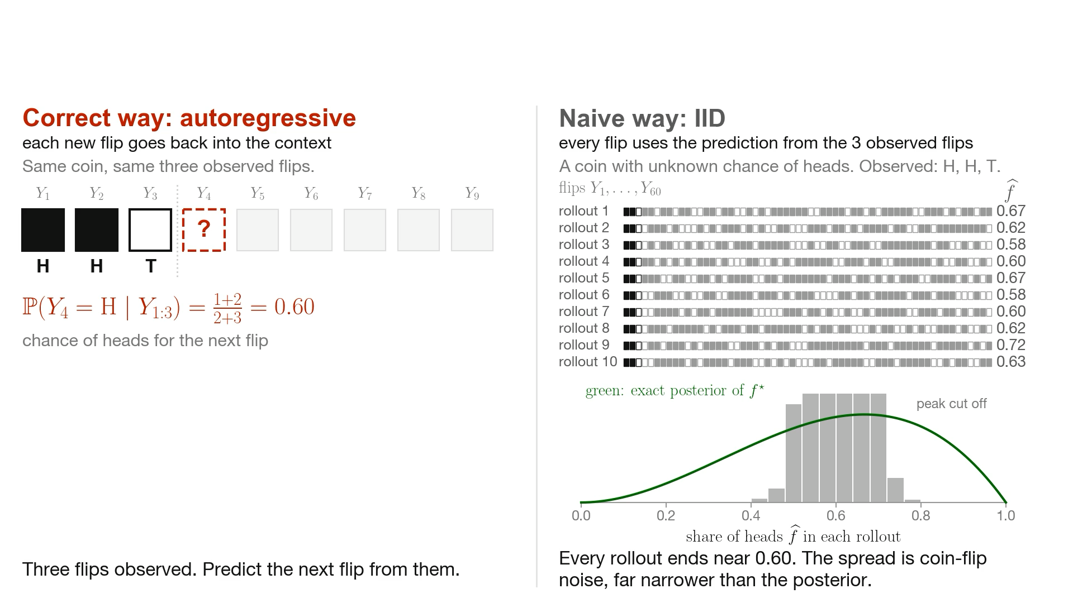
Autoregressive generation
Our autoregressive approach

Slide 20
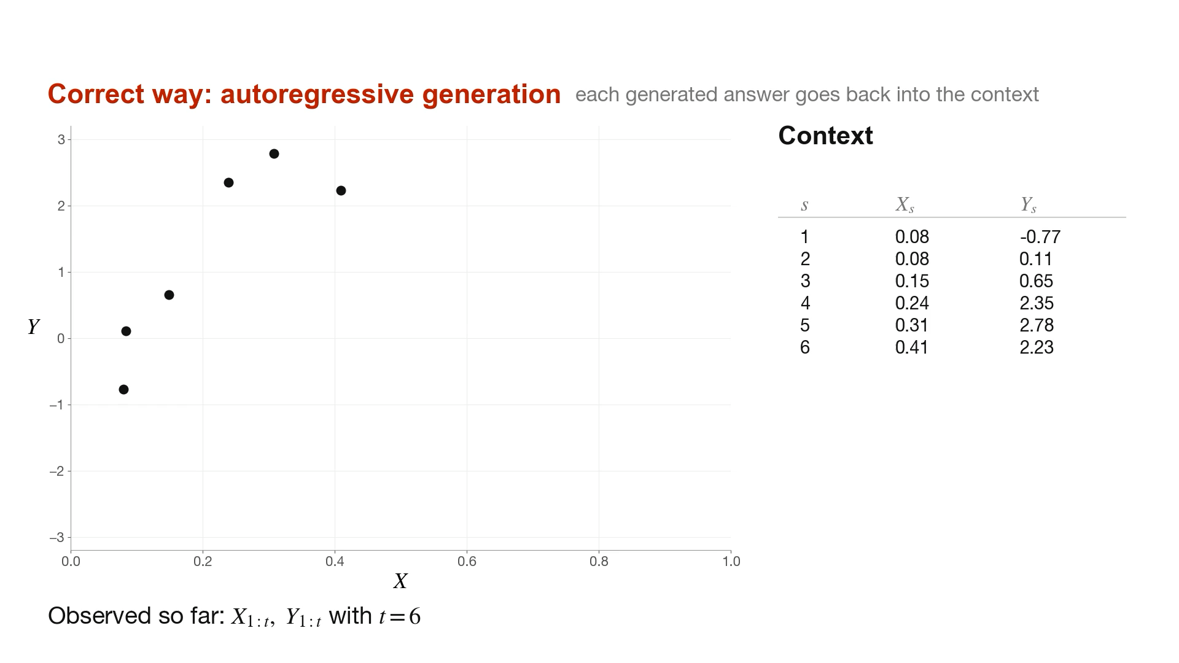
Contexts $X$ and heteroskedasticity

Slide 21
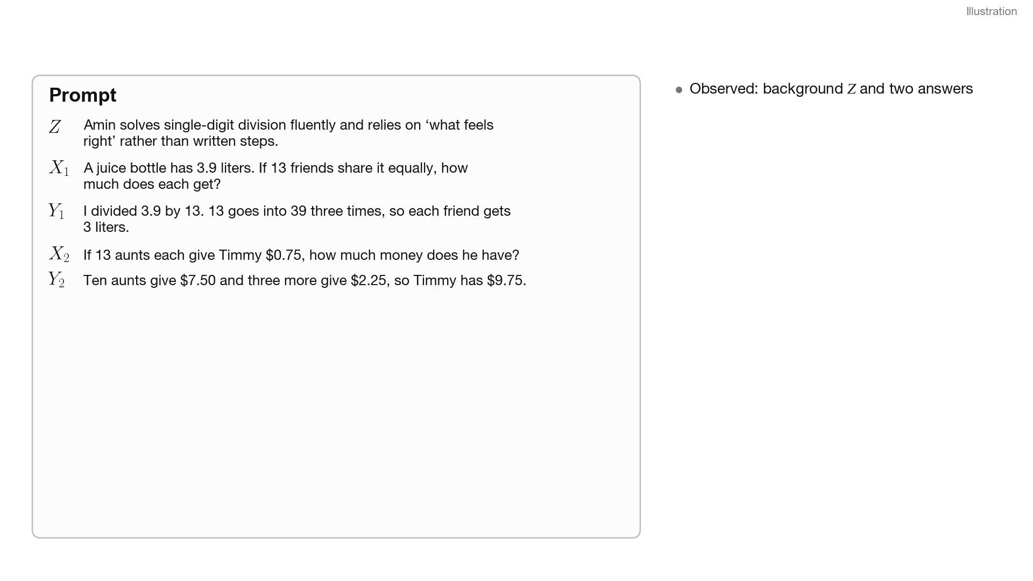
Language data

Slide 22
Our approach
Uncertainty comes from missing data yet to be observed
Prior information on student
Amin generally solves single-digit division problems fluently and uses repeated subtraction when working with larger numbers. When asked to explain his reasoning, he often relies on ‘what feels right’ rather than written strategies. He’s more confident when problems are framed in real-life contexts, like sharing food or money, and shows persistence even when confused.
Amin

Slide 23
Our approach
Uncertainty comes from missing data yet to be observed
Prior information on student
Question: A juice bottle has 3.9 liters. If I share it equally among 13 friends how many liters does each get?
Question: If 13 aunts each give Timmy $0.75 for Christmas, how much does he have?
…
Amin generally solves single-digit division problems fluently and uses repeated subtraction when working with larger numbers. When asked to explain his reasoning, he often relies on ‘what feels right’ rather than written strategies. He’s more confident when problems are framed in real-life contexts, like sharing food or money, and shows persistence even when confused.
Uncertainty arises out of missing data rather than latent parameters
Amin

Slide 24
Our approach
Uncertainty comes from missing data yet to be observed
Prior information on student
Question: A juice bottle has 3.9 liters. If I share it equally among 13 friends how many liters does each get?
Question: If 13 aunts each give Timmy $0.75 for Christmas, how much does he have?
…
Amin generally solves single-digit division problems fluently and uses repeated subtraction when working with larger numbers. When asked to explain his reasoning, he often relies on ‘what feels right’ rather than written strategies. He’s more confident when problems are framed in real-life contexts, like sharing food or money, and shows persistence even when confused.
A. 0.03 liters
B. 0.3 liters
C. 0.39 liters
D. 3 liters
E. Approximately 3 liters
A. $1.75
B. $9.75
C. $10.75
D. $12.75
E. $13.75
Amin

Slide 25
Autoregressive generation as posterior inference
$Z$
(prior info)
Amin generally solves single-digit division problems fluently and uses repeated subtraction when working with larger numbers. When asked to explain her reasoning, he often relies on ‘what feels right’ rather than written strategies. He’s confident when……
$$X_{1}$$
A juice bottle has 3.9 liters. If I share it equally among 13 friends how many...
$$Y_{1}$$
I divided 3.9 by 13 and got 3, so I think each friend gets 3 liters. Answer: D
$$X_{2}$$
If 13 aunts each give Timmy $0.75 for Christmas, how much does he have?
$$Y_{2}$$
I multiply 13 × 0.75 and get $9.75 total. Answer: B
Notes:
do a time step by step version of this. state de finetti.

Slide 26
Autoregressive generation as posterior inference
$Z$
(prior info)
Amin generally solves single-digit division problems fluently and uses repeated subtraction when working with larger numbers. When asked to explain her reasoning, he often relies on ‘what feels right’ rather than written strategies. He’s confident when……
$$X_{1}$$
A juice bottle has 3.9 liters. If I share it equally among 13 friends how many...
$$Y_{1}$$
I divided 3.9 by 13 and got 3, so I think each friend gets 3 liters. Answer: D
$$X_{2}$$
If 13 aunts each give Timmy $0.75 for Christmas, how much does he have?
$$Y_{2}$$
I multiply 13 × 0.75 and get $9.75 total. Answer: B
$$X_{3}$$
If Erin makes $1375 per 11-hour work day, how much does she make per hour?
Problem bank
$$X_{4}$$
A water bottle has 0.60 liters. Pour it equally into 2 cups. How many liters per…

Slide 27
Autoregressive generation as posterior inference
$Z$
(prior info)
Amin generally solves single-digit division problems fluently and uses repeated subtraction when working with larger numbers. When asked to explain her reasoning, he often relies on ‘what feels right’ rather than written strategies. He’s confident when……
$$X_{1}$$
A juice bottle has 3.9 liters. If I share it equally among 13 friends how many...
$$Y_{1}$$
I divided 3.9 by 13 and got 3, so I think each friend gets 3 liters. Answer: D
$$X_{2}$$
If 13 aunts each give Timmy $0.75 for Christmas, how much does he have?
$$Y_{2}$$
I multiply 13 × 0.75 and get $9.75 total. Answer: B
Autoregressively simulate from LLM
$$X_{3}$$
If Erin makes $1375 per 11-hour work day, how much does she make per hour?
I divide $1375 by 11 hours, which gives me $125 per hour. Answer: A
Problem bank
$$X_{4}$$
A water bottle has 0.60 liters. Pour it equally into 2 cups. How many liters per…
I divide 0.60 by 2 and get 0.06 liters per cup. Answer: C

Slide 28
Autoregressive generation as posterior inference
$Z$
(prior info)
Amin generally solves single-digit division problems fluently and uses repeated subtraction when working with larger numbers. When asked to explain her reasoning, he often relies on ‘what feels right’ rather than written strategies. He’s confident when……
$$X_{1}$$
A juice bottle has 3.9 liters. If I share it equally among 13 friends how many...
$$Y_{1}$$
I divided 3.9 by 13 and got 3, so I think each friend gets 3 liters. Answer: D
$$X_{2}$$
If 13 aunts each give Timmy $0.75 for Christmas, how much does he have?
$$Y_{2}$$
I multiply 13 × 0.75 and get $9.75 total. Answer: B
Autoregressively simulate from LLM
$$X_{3}$$
If Erin makes $1375 per 11-hour work day, how much does she make per hour?
I divided $1375 by 11 and got $137.50 per hour. Answer: C
Problem bank
$$X_{4}$$
A water bottle has 0.60 liters. Pour it equally into 2 cups. How many liters per…
I divide 0.60 by 2 and get 0.30 liters per cup. Answer: D

Slide 29
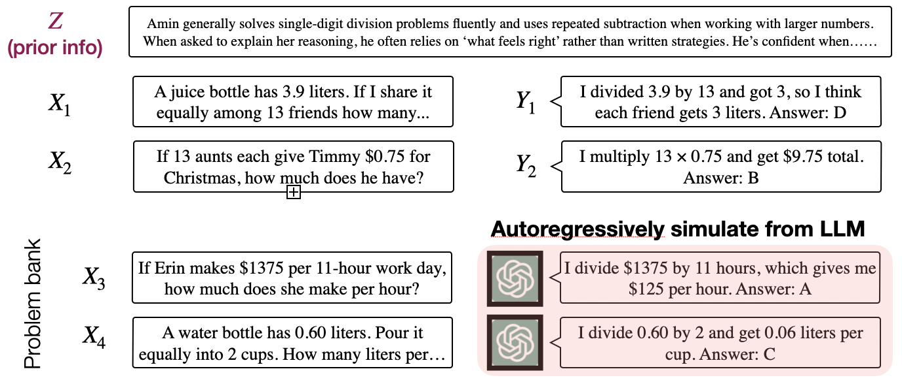
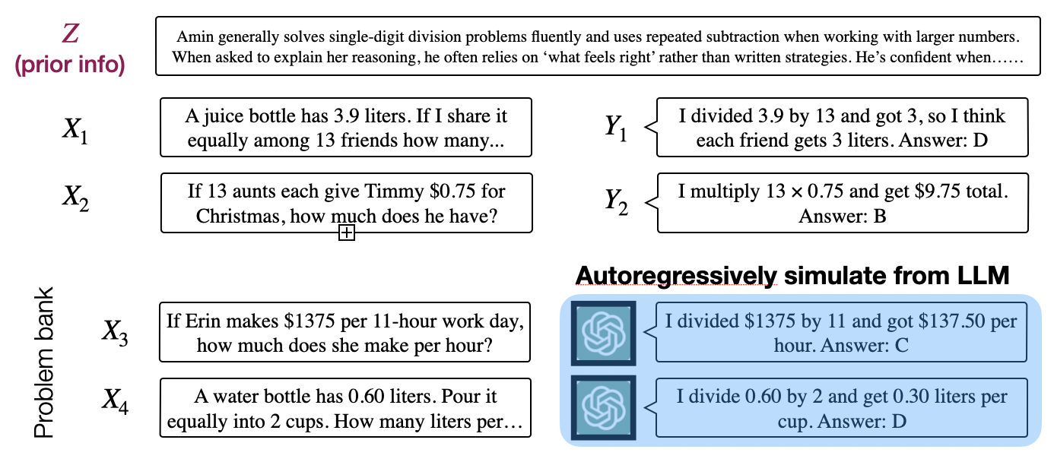
Uncertainty = variability in inferred diagnosis
(
)
=
Demonstrates basic understanding of division but frequently misplaces the decimal when dividing a decimal by a whole number, especially in real-world contexts involving money or measurements. They often round…
Variability reflects uncertainty
…
(
)
=
Can correctly perform multi-digit division using standard algorithm but struggles to explain why the steps work or how answer relates to the problem context. Suggests strong procedural fluency but limited conceptual…..

Slide 30
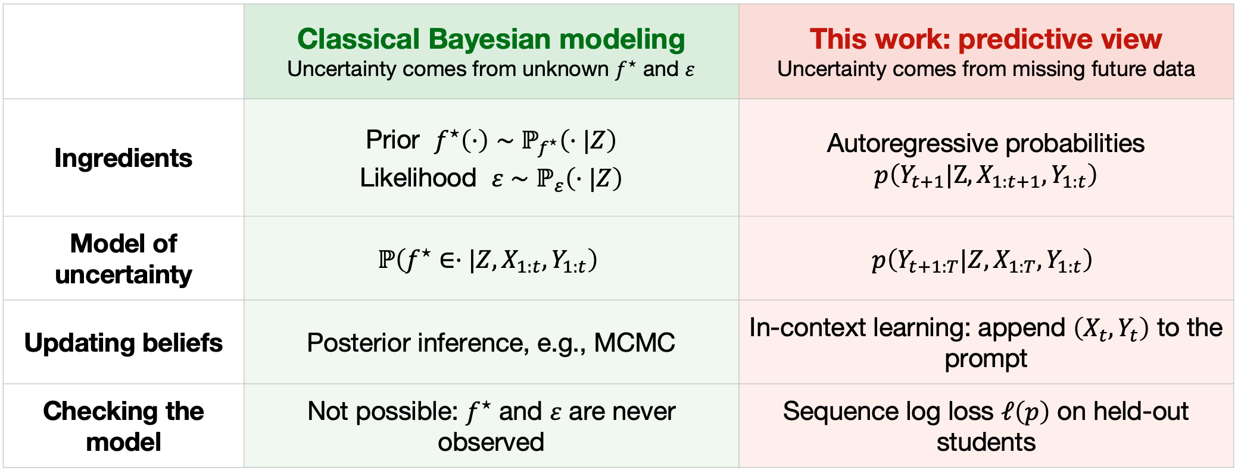
“Modeling” = Training sequence predictors

Slide 31
Predictive loss controls posterior quality
Sequence prediction loss $ℓ_{t:T}(p):=-E_{t}\left[\overset{T-1}{\underset{s=t}{∑}}logp(Y_{s+1}∣Z,X_{1:s+1},Y_{1:s})\right]$
Notes:
highlight that unlike bayesian statisticians we don’t require the p to be exchangeable. all that amtters is good predictive performance

Slide 32
Predictive loss controls posterior quality
Sequence prediction loss $ℓ_{t:T}(p):=-E_{t}\left[\overset{T-1}{\underset{s=t}{∑}}logp(Y_{s+1}∣Z,X_{1:s+1},Y_{1:s})\right]$
(Ye & N. ’26) As long as there is $\overset{̂}{f}$ fitted from data generated by $\overset{̂}{p}$
$\left|\underset{⏟}{P(τ(f^{⋆})∈{\overset{̂}{C}}_{t}∣past)-95\%}\right|≤\sqrt{1-exp\left(-\lim_{T→∞}\left(ℓ_{t:T}(\overset{̂}{p})-ℓ_{t:T}(p^{⋆})\right)\right)}$
error in confidence interval coverage
Notes:
highlight that unlike bayesian statisticians we don’t require the p to be exchangeable. all that amtters is good predictive performance

Slide 33
Predictive loss controls posterior quality
Sequence prediction loss $ℓ_{t:T}(p):=-E_{t}\left[\overset{T-1}{\underset{s=t}{∑}}logp(Y_{s+1}∣Z,X_{1:s+1},Y_{1:s})\right]$
Predictive loss over right outcomes controls quality of UQ!
$\overset{̂}{p}$ doesn’t have to be exchangeable so long as it provides a consistent estimator
(Ye & N. ’26) As long as there is $\overset{̂}{f}$ fitted from data generated by $\overset{̂}{p}$
$\left|\underset{⏟}{P(τ(f^{⋆})∈{\overset{̂}{C}}_{t}∣past)-95\%}\right|≤\sqrt{1-exp\left(-\lim_{T→∞}\left(ℓ_{t:T}(\overset{̂}{p})-ℓ_{t:T}(p^{⋆})\right)\right)}$
error in confidence interval coverage
Notes:
highlight that unlike bayesian statisticians we don’t require the p to be exchangeable. all that amtters is good predictive performance

Slide 34
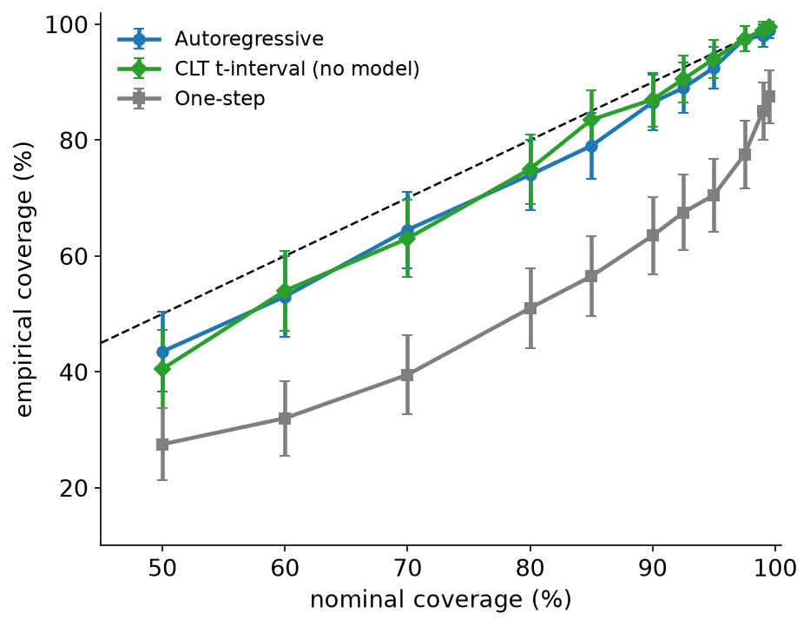
Sanity check
Can we turn a tabular foundation model into a statistician?
Let’s consider a one-dimensional estimand instead of a whole function $f^{⋆}$
In this case, classical statistical machinery (aka CLT) works well
Estimand: prob. of prolonged ventilation at CUMC
Can tabular FMs produce good confidence intervals?
n=1000

Slide 35
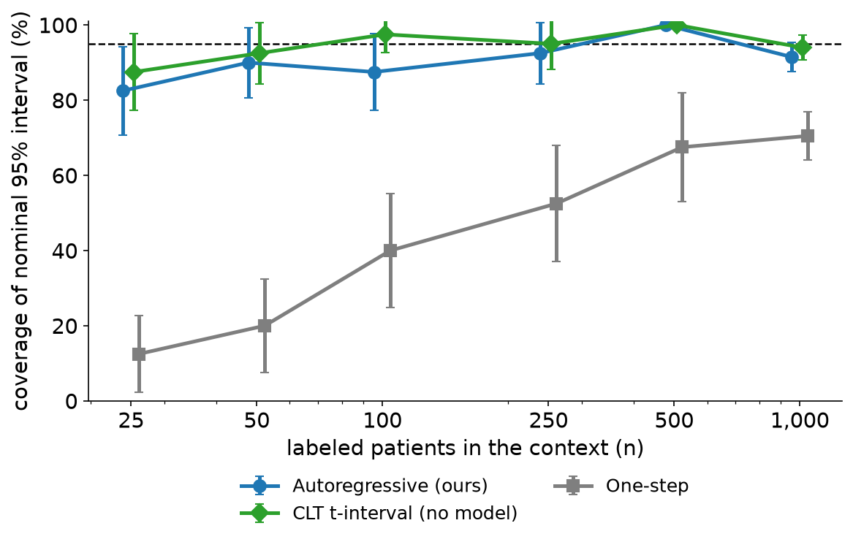
Sanity check
Can we turn a tabular foundation model into a statistician?
Let’s consider a one-dimensional estimand instead of a whole function $f^{⋆}$
In this case, classical statistical machinery (aka CLT) works well
Estimand: prob. of prolonged ventilation at CUMC
Can tabular FMs produce good confidence intervals?

Slide 36
Comparison to industry standard
Fit $\overset{̂}{f}(x)$ on bootstrapped data, and pretend ${\overset{̂}{f}}_{1},…,{\overset{̂}{f}}_{20}$ is your universe
Challenges
Very unstable: we need to regularize/smooth when data is small, but it’s unclear how to because there is no notion of val loss to tune
Hard to update when you get one more response $(X_{11},Y_{11})$ from Amin
Can’t learn across $Z$’s (“prior information”)
Consequently, cold start problem largely remains unsolved

Slide 37
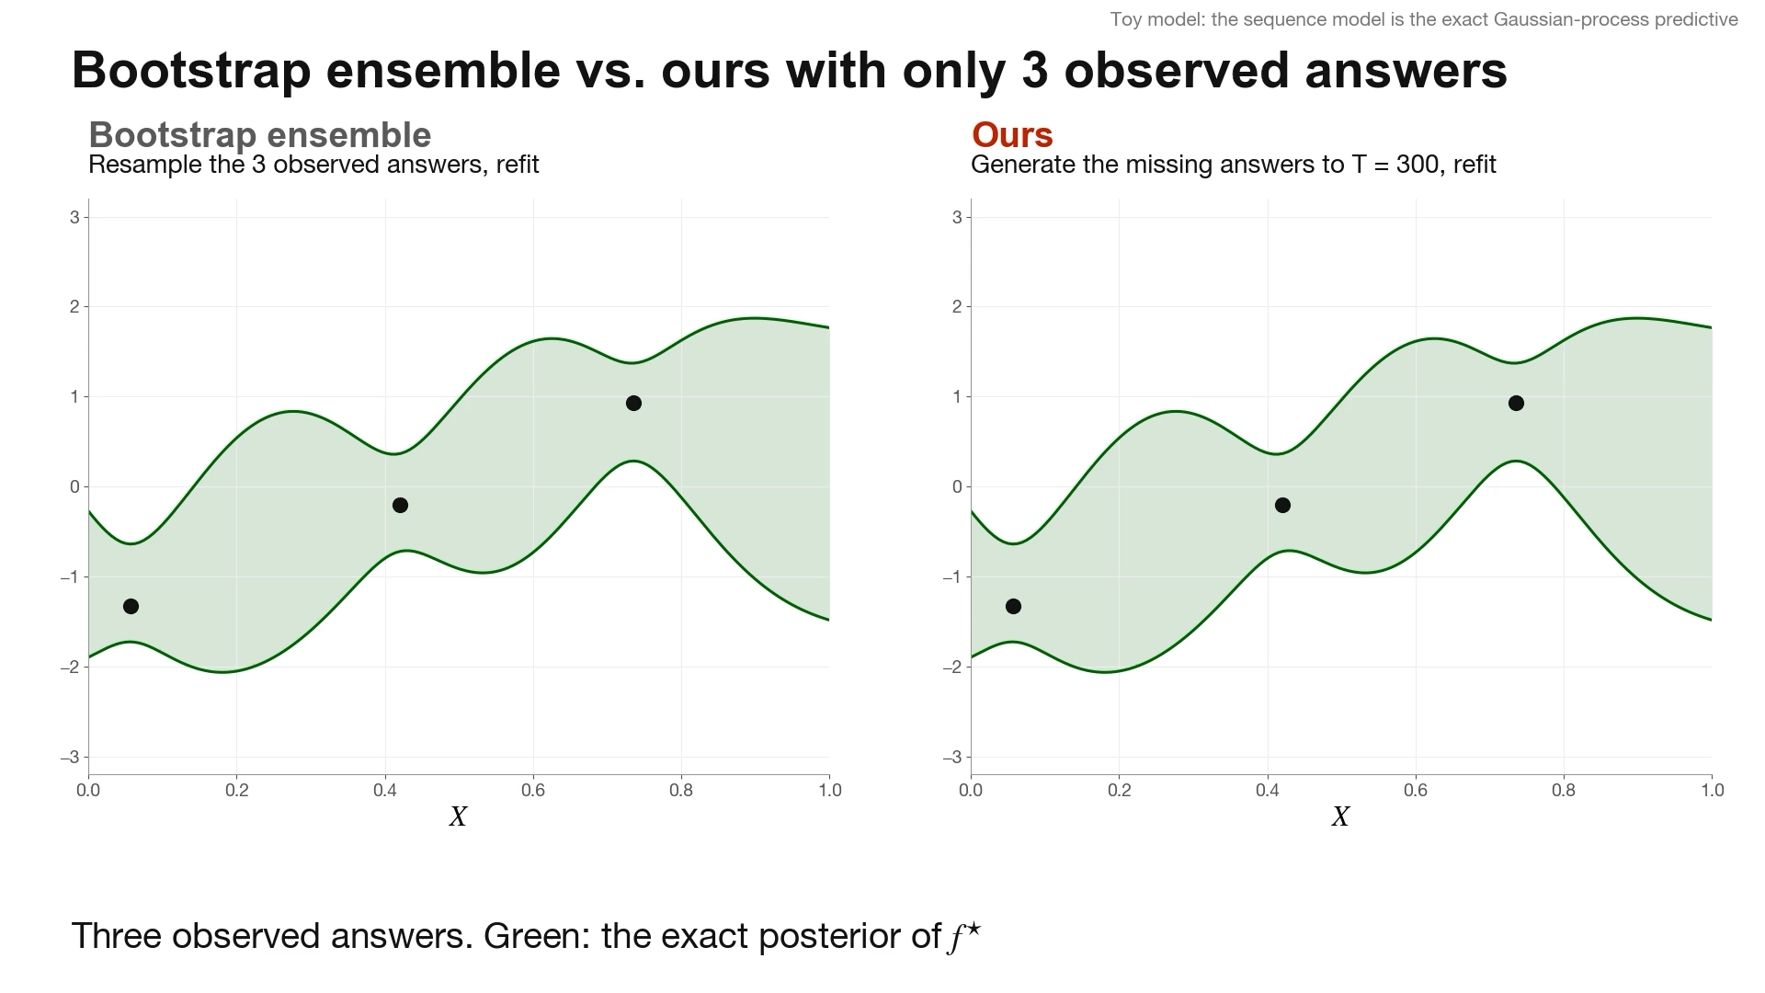

Slide 38
Related work
Modeling joint distribution was challenging before LLMs
De Finnetti (’29): exchangeable sequence modeling = latent factor models
  Geisser (’71), Rubin (’78) espouse similar idea, but found it “too burdensome to be worthwhile”; resorts to typical latent variable modeling
Martingale posteriors handpick autoregressive probabilities and don’t view sequence prediction loss as the fundamental learning objective
[Berti et al. (’98, ’21, ’22), Fortini et al. (’14, ’23), Fong et al. (’23), Holmes & Walker (’23), Falck et al. (’24)]
Our view: it doesn’t matter whether $\overset{̂}{p}(⋅)$ is exchangeable so long as it’s a good sequence predictor
This allows us to repurpose foundation models as a statistician!

Slide 39
How does this help decisions?
Vignette in adaptive experimentation

Slide 40
Adaptive experimentation as a MDP
Action: which information to gather next?
State: current posterior belief
[Gittins & Jones (’74), Kaelbling et al. (’98), Ghavamzadeh et al. (’15), Frazier et al. (’09), Powell & Ryzhov (’12), Brown & Smith (’13), Wang & Zenios (2020)]

Slide 41
Adaptive experimentation as a MDP
Action that maximally resolves uncertainty
Action: which information to gather next?
Outcome
State: current posterior belief
[Gittins & Jones (’74), Kaelbling et al. (’98), Ghavamzadeh et al. (’15), Frazier et al. (’09), Powell & Ryzhov (’12), Brown & Smith (’13), Wang & Zenios (2020)]

Slide 42
Adaptive experimentation as a MDP
Action that maximally resolves uncertainty
Action: which information to gather next?
Outcome
State: current posterior belief
Reward:
reduction in uncertainty
[Gittins & Jones (’74), Kaelbling et al. (’98), Ghavamzadeh et al. (’15), Frazier et al. (’09), Powell & Ryzhov (’12), Brown & Smith (’13), Wang & Zenios (2020)]

Slide 43
Adaptive experimentation as a MDP
Action that maximally resolves uncertainty
Action: which information to gather next?
Outcome
State: current posterior belief
Reward:
reduction in uncertainty
Answer appended to LLM prompt (“state transition”)
[Gittins & Jones (’74), Kaelbling et al. (’98), Ghavamzadeh et al. (’15), Frazier et al. (’09), Powell & Ryzhov (’12), Brown & Smith (’13), Wang & Zenios (2020)]

Slide 44
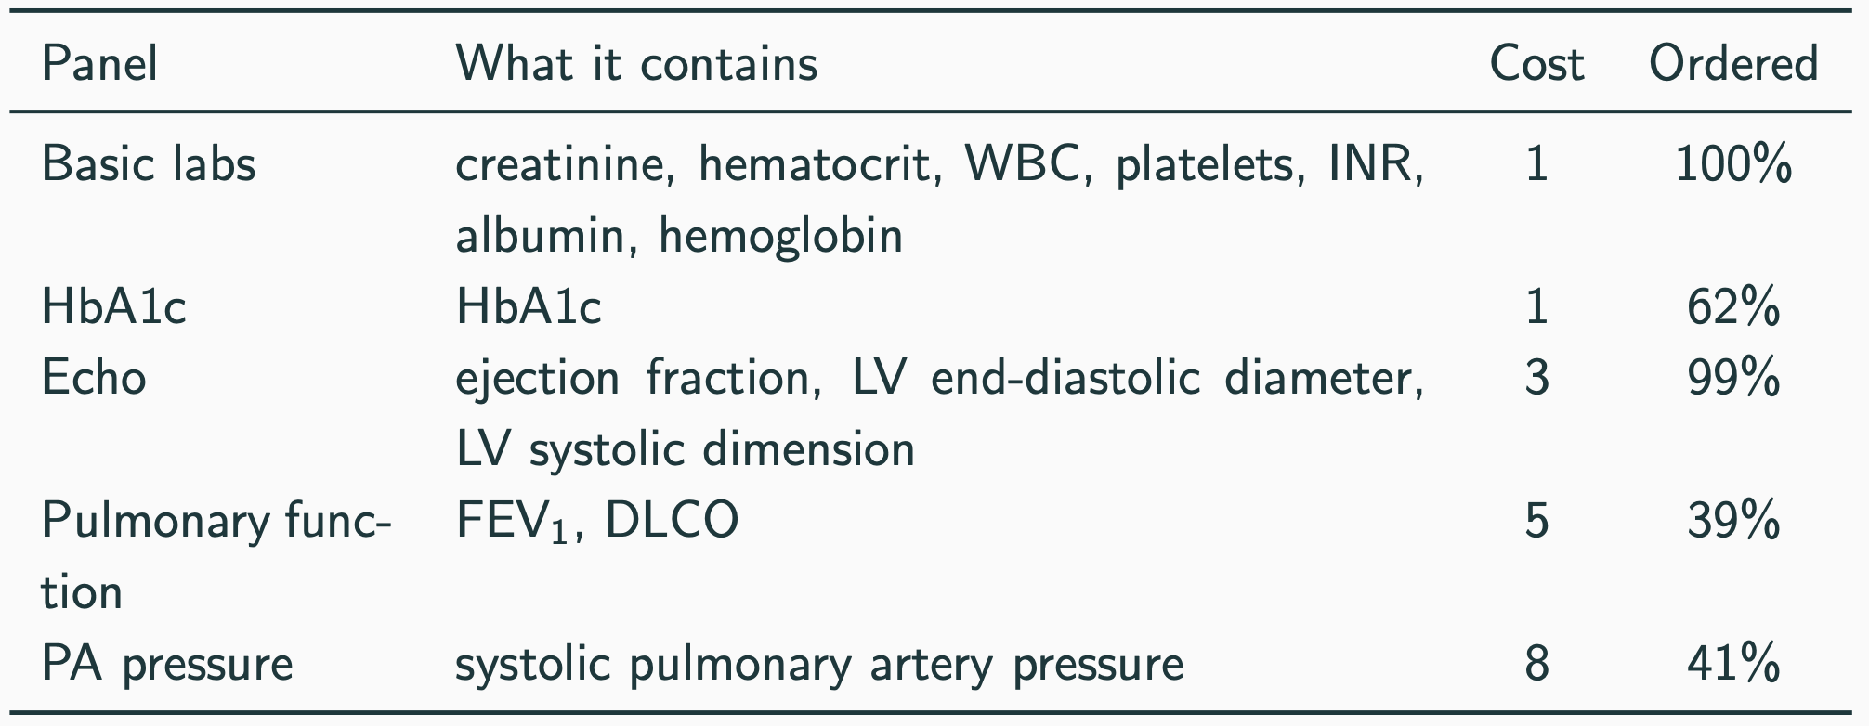
Adaptive exams to predict prolonged ventilation
Retrospective case study
Substantial heteroskedasticity over covariates: demographics, lab results, comorbidities, preop meds, op type etc.
Ignorability: clinician’s orders independent of outcome given observed history. (This is incorrect, e.g., patients who got PFT are sicker)
Notes:
The key idea: no physician behaviour is simulated. We restrict the evaluation to 749 test patients for whom every panel was actually measured in the registry. The five panels, with their costs, are:
labs (1)
HbA1c (1)
echo (3)
PFT (5)
PA pressure (8)

Slide 45
Adaptive exams to predict prolonged ventilation
Retrospective case study
Exam
Action: HbA1c, Echo, PFT, PA pressure
State: TabPFN prompted with information so far

Slide 46
Adaptive exams to predict prolonged ventilation
Retrospective case study
Action that maximally resolves uncertainty
Exam
Action: HbA1c, Echo, PFT, PA pressure
State: TabPFN prompted with information so far
Reward:
Loss reduction between TabPFN with vs. without new exam

Slide 47
Adaptive exams to predict prolonged ventilation
Retrospective case study
Action that maximally resolves uncertainty
Exam
Action: HbA1c, Echo, PFT, PA pressure
State: TabPFN prompted with information so far
Reward:
Loss reduction between TabPFN with vs. without new exam
Answer appended to TabPFN prompt (“state transition”)

Slide 48
Adaptive exams to predict prolonged ventilation
Retrospective case study
Action that maximally resolves uncertainty
Exam
Action: HbA1c, Echo, PFT, PA pressure
State: TabPFN prompted with information so far
Reward:
Loss reduction between TabPFN with vs. without new exam
Answer appended to TabPFN prompt (“state transition”)
Today: pick exams with highest ratio of uncertainty reduction / cost
Notes:
For each panel not yet ordered, TabPFN draws 16 plausible values of that panel, given what is already known about the patient.
It measures how much those values would reduce uncertainty about the outcome, and divides by the panel’s cost.
It orders the panel with the best ratio.

Slide 49
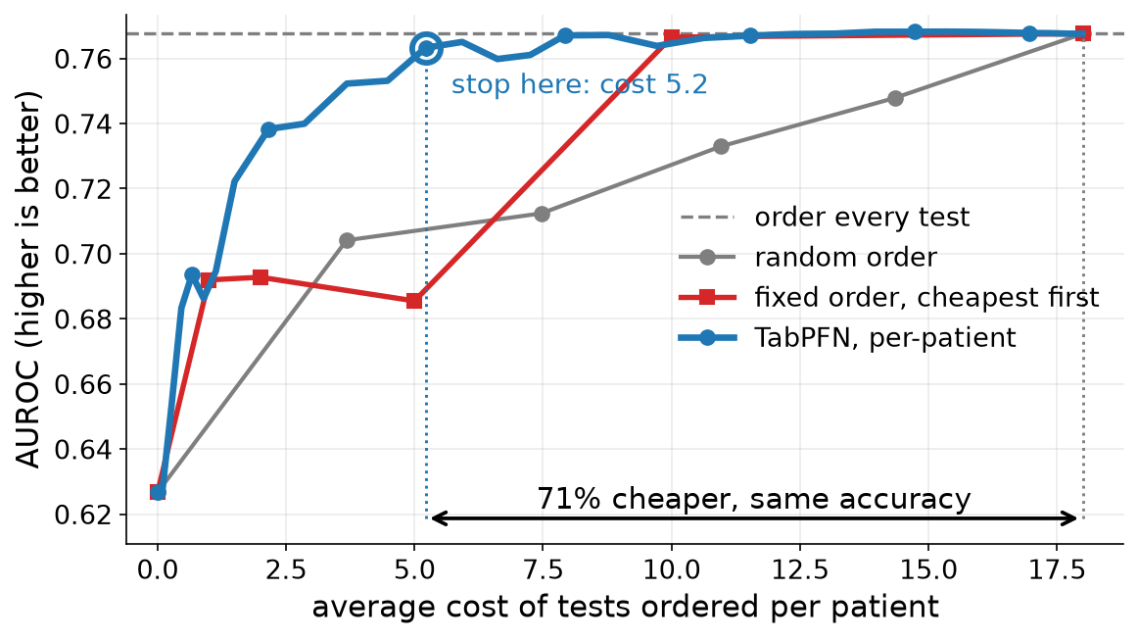
Adaptive exams to predict prolonged ventilation
Retrospective case study

Slide 50
Conceptual advantages
Sequence model serves both as a state, a simulator of the future, and prediction model
New information can be simulated by masking tokens in the tabular foundation model regardless of feature or outcome
Value of new info measured by comparing the sequence model’s prediction with & w/o
Rollouts have known dynamics
(in-context learning within a transformer)
Allows auto-differentiation-based planning
(aka model predictive control)
Real and simulated observations so far
Next outcome prediction

Slide 51
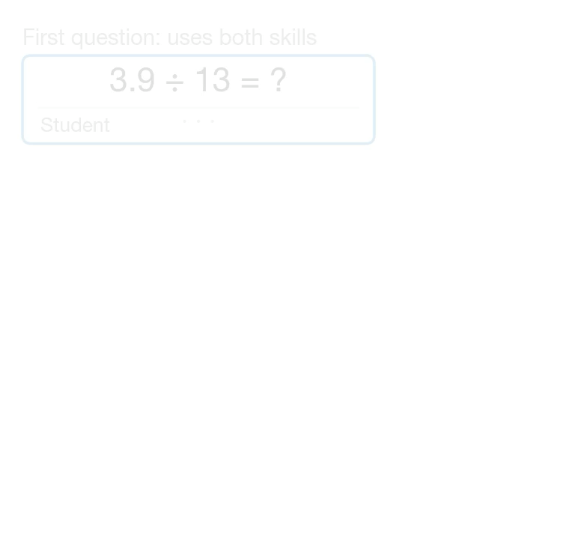
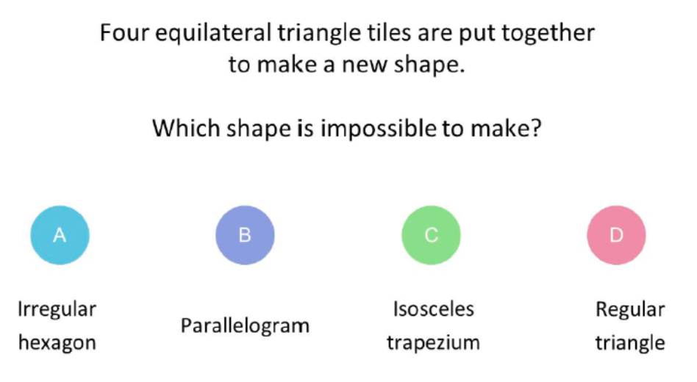
Natural language example
Real-world dataset from an online education platform
~1K multiple choice questions on algebra, number theory, and geometry
Finetune Llama 3.1on individual responses from students (LoRA)
Example question from EEDI
Diagnostic questions: The NeurIPS 2020 education challenge. https://diagnosticquestions.com/ Wang et al. (2020)

Slide 52
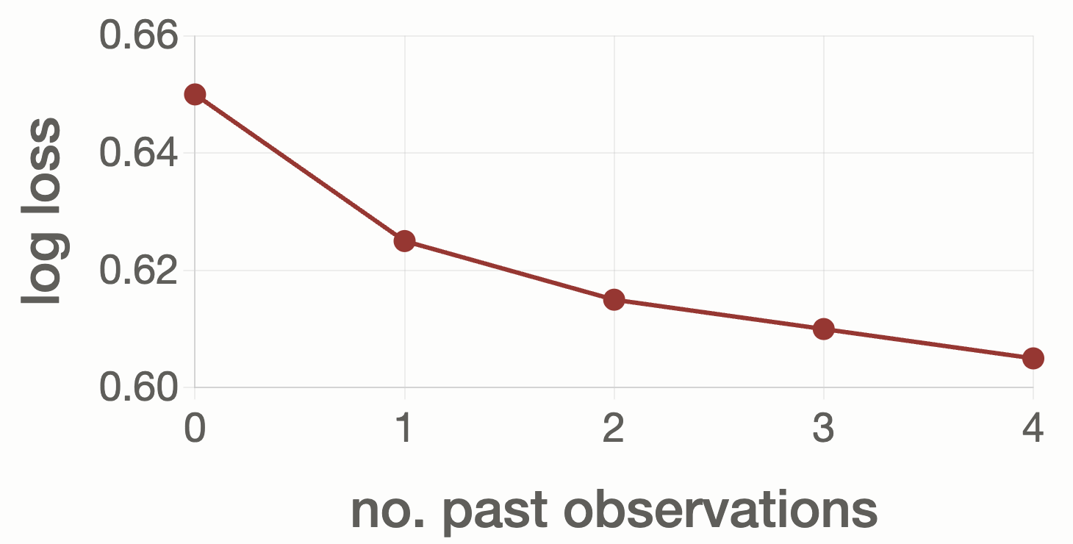
Natural language example
Real-world dataset from an online education platform
~1K multiple choice questions on algebra, number theory, and geometry
Finetune Llama 3.1on individual responses from students (LoRA)
Example question from EEDI
Diagnostic questions: The NeurIPS 2020 education challenge. https://diagnosticquestions.com/ Wang et al. (2020)

Slide 53
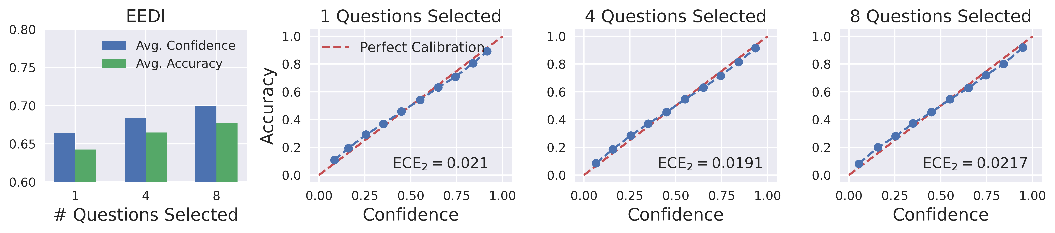
Natural language example
Predicted probabilities on student answer sensible?
y = Fraction( correct | confidence = x); we want this to be equal to x

Slide 54
Adaptive exams for student assessment
MDP formulation
Reduce uncertainty on future responses as measured by
Entropy( student answers to all questions in problem bank )
Predictive view

Slide 55
Adaptive exams for student assessment
Reduce uncertainty on future responses as measured by
Entropy( student answers to all questions in problem bank )
Predictive view
Action: which question to pick next?
State: current posterior

Slide 56
Adaptive exams for student assessment
Reduce uncertainty on future responses as measured by
Entropy( student answers to all questions in problem bank )
Predictive view
Select Q that can maximally resolve future uncertainty
Action: which question to pick next?
State: current posterior

Slide 57
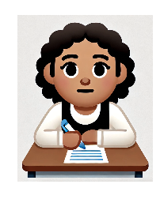
Adaptive exams for student assessment
Reduce uncertainty on future responses as measured by
Entropy( student answers to all questions in problem bank )
Predictive view
Select Q that can maximally resolve future uncertainty
Answer
Action: which question to pick next?
State: current posterior

Slide 58
Adaptive exams for student assessment
Reduce uncertainty on future responses as measured by
Entropy( student answers to all questions in problem bank )
Predictive view
Select Q that can maximally resolve future uncertainty
Answer
Action: which question to pick next?
State: current posterior
Reward:
reduction in entropy

Slide 59
Adaptive exams for student assessment
Reduce uncertainty on future responses as measured by
Entropy( student answers to all questions in problem bank )
Predictive view
Select Q that can maximally resolve future uncertainty
Answer
Action: which question to pick next?
State: current posterior
Reward:
reduction in entropy
Answer appended to LLM prompt (“state transition”)
[Gittins & Jones (’74), Kaelbling et al. (’98), Ghavamzadeh et al. (’15), Frazier et al. (’09), Powell & Ryzhov (’12), Brown & Smith (’13), Wang & Zenios (2020)]

Slide 60
Adaptive exams for student assessment
Reduce uncertainty on future responses as measured by
Entropy( student answers to all questions in problem bank )
Predictive view
To (approximately) solve this MDP, we must
  form informed prior based on information on the student
  use question and solution to comprehend areas of largest uncertainty
  select questions balancing exploration & exploitation
  sharpen beliefs based on the student’s answer

Slide 61
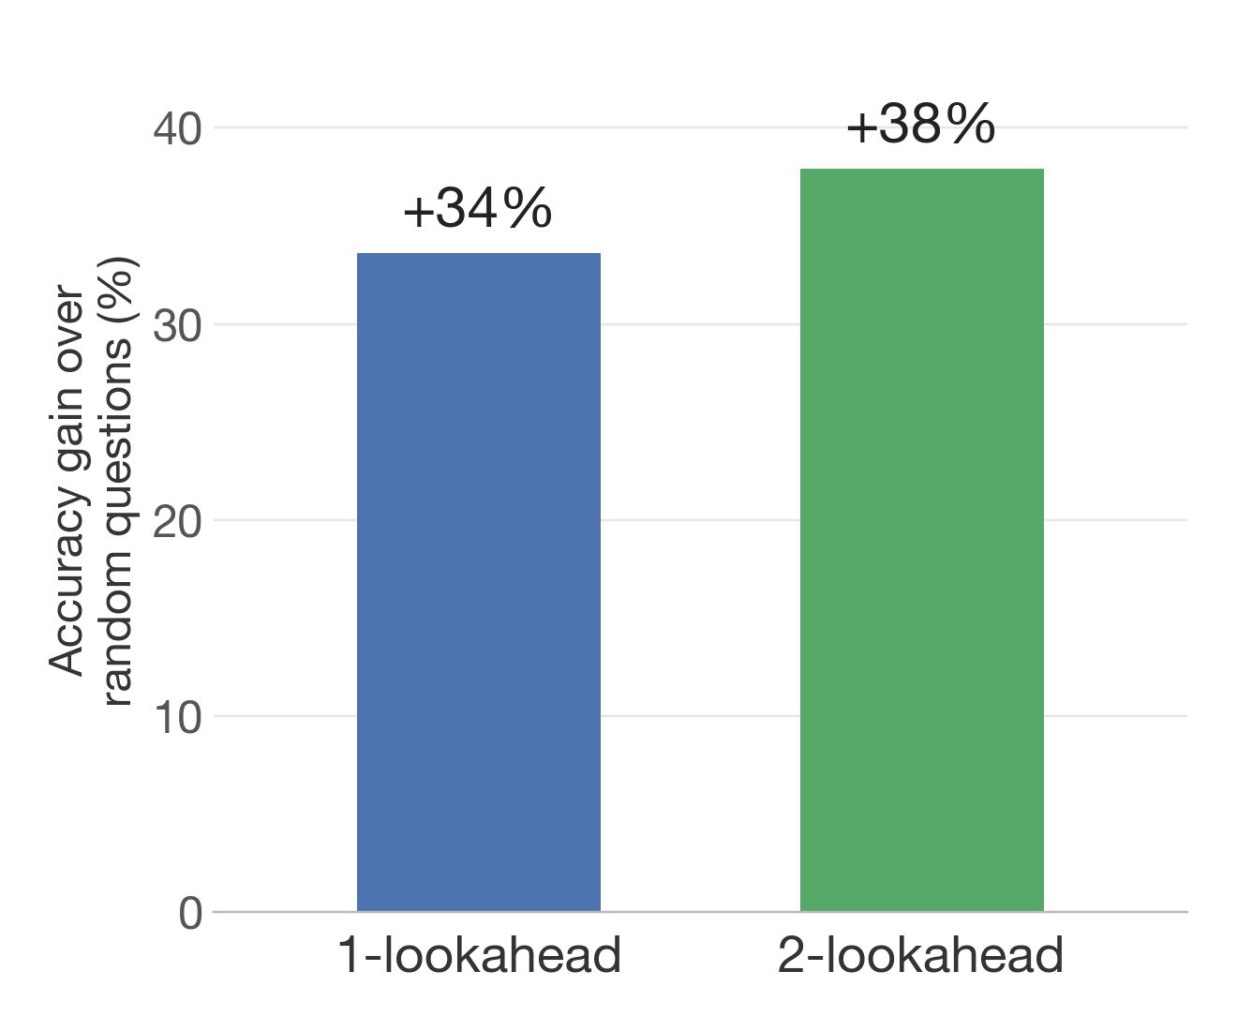
Adaptive exams for student assessment
Adaptive vs random questions
Most of a student’s answers match what most students say, so the population prior already predicts them
What we need to learn is where this student differs, e.g., Amin divides well but misplaces decimals. Each student is scored on answers that fewer than 30% of students give.
There, adaptive questions predict the student up to 38% more accurately than random questions

Slide 62
Theoretical insights
Progress in LLM pre-training directly improves interactive decision-making performance
[Liu & Li (’16), Phan et al. (’19), Simchowitz et al. (’21), Liu et al. (’22), Hamidi & Bayati (’23)]

Slide 63
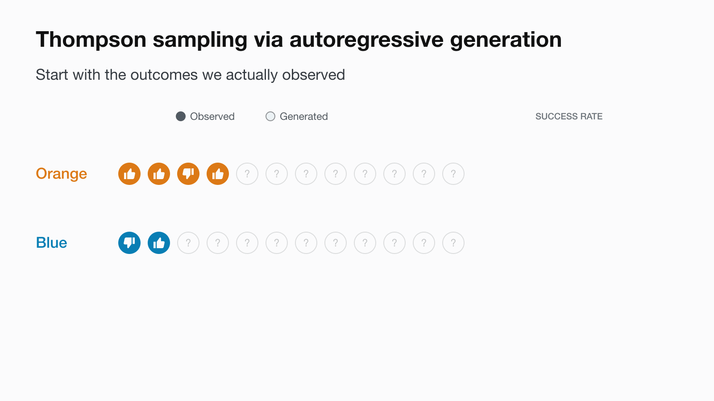
Liu, Van Roy & Xu (’23) condition on generated future outcomes to guide exploration under known nonstationary dynamics

Slide 64
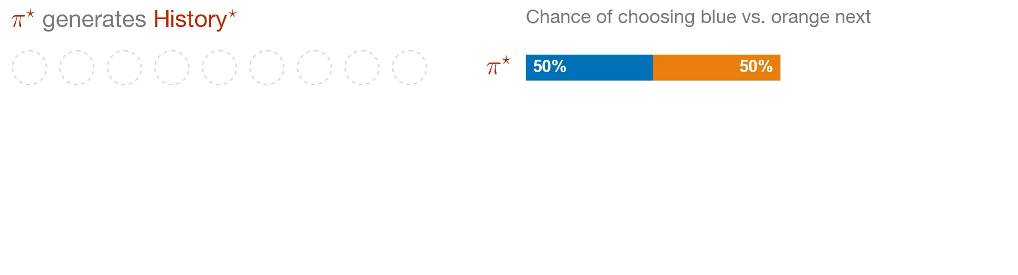
Misspecification
Can initially small errors cascade over time?
$π^{⋆}$: policy based on the true sequence model $p^{⋆}$
$\overset{̂}{π}$ : policy based on the approximate sequence model $\overset{̂}{p}$

Slide 65
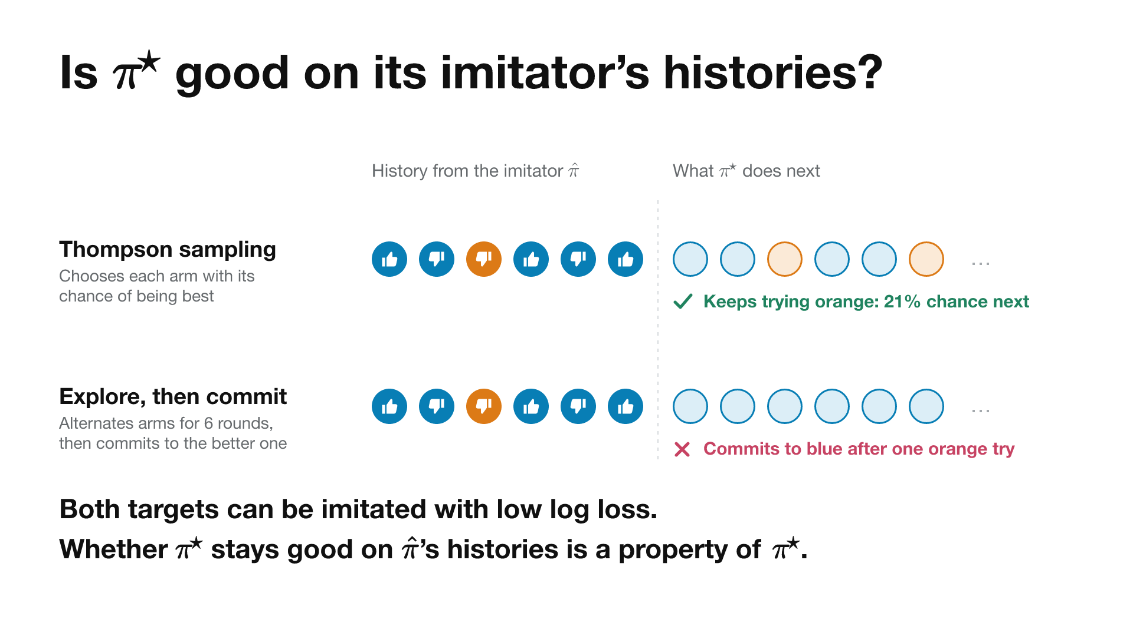
Is $π^{⋆}$ any good on $\overset{̂}{π}$’s history?
Typical guarantees say $π^{⋆}$ makes good decisions when it generates ${\text{History}}^{⋆}$
But what about $π^{⋆}$’s decisions on $\overset{̂}{\text{History}}$?
$$\overset{̂}{\text{History}}$$

Slide 66
Bayes regret controlled by sequence loss
Assume potential outcomes across arms are independent
Assume units/observations within an arm are exchangeable

Slide 67
Bayes regret controlled by sequence loss
Assume potential outcomes across arms are independent
Assume units/observations within an arm are exchangeable
Theorem (CNRZ’24)
Impossible to implement
Val loss
Regret of TS with model $\overset{̂}{p}$
Regret of oracle TS with true model $p^{⋆}$
$$+\sqrt{2⋅\text{no. actions}⋅(ℓ_{T}(\overset{̂}{p})-ℓ_{T}(p^{⋆}))}$$
$$≤$$
On average, initially small disparities don’t magnify over time
Scaling laws govern online decision-making performance!

Slide 68

Back in 2019 at Meta
Decisions have to be made fast in online platforms; TS too slow!
Powered by the observation that TS is robust to single-step errors, we shipped a fast policy trained to mimic TS
A/B test: up to 5× the share of videos preserved at 1080p, leading to 1.1% increase watch time.
Theorem (NDB’26)
Imitating TS on the learner’s own histories preserves the usual Bayes regret bound, up to additive imitation errors.

Slide 69
Summary
Meta-learning across datasets provides a robust prediction machine
Our conceptual framework turns this into a new primitive for UQ: autoregressive generation is key to valid statistical inference!
We formulate a MDP over predictive distributions, and approximately solve it using classical heuristics like TS and lookaheads
For TS, approximation error accrues additively, and hence is controlled by sequence prediction loss
[Uncertainty as missing data] Active Exploration via Autoregressive Generation of Missing Data, CNRZ, 2024
[Language experiments] Adaptive Elicitation of Latent Information Using Natural Language, WZZN, 2025
[Bayesian connections] Exchangeable Sequence Models Quantify Uncertainty Over Latent Concepts, YN, 2024

Slide 70
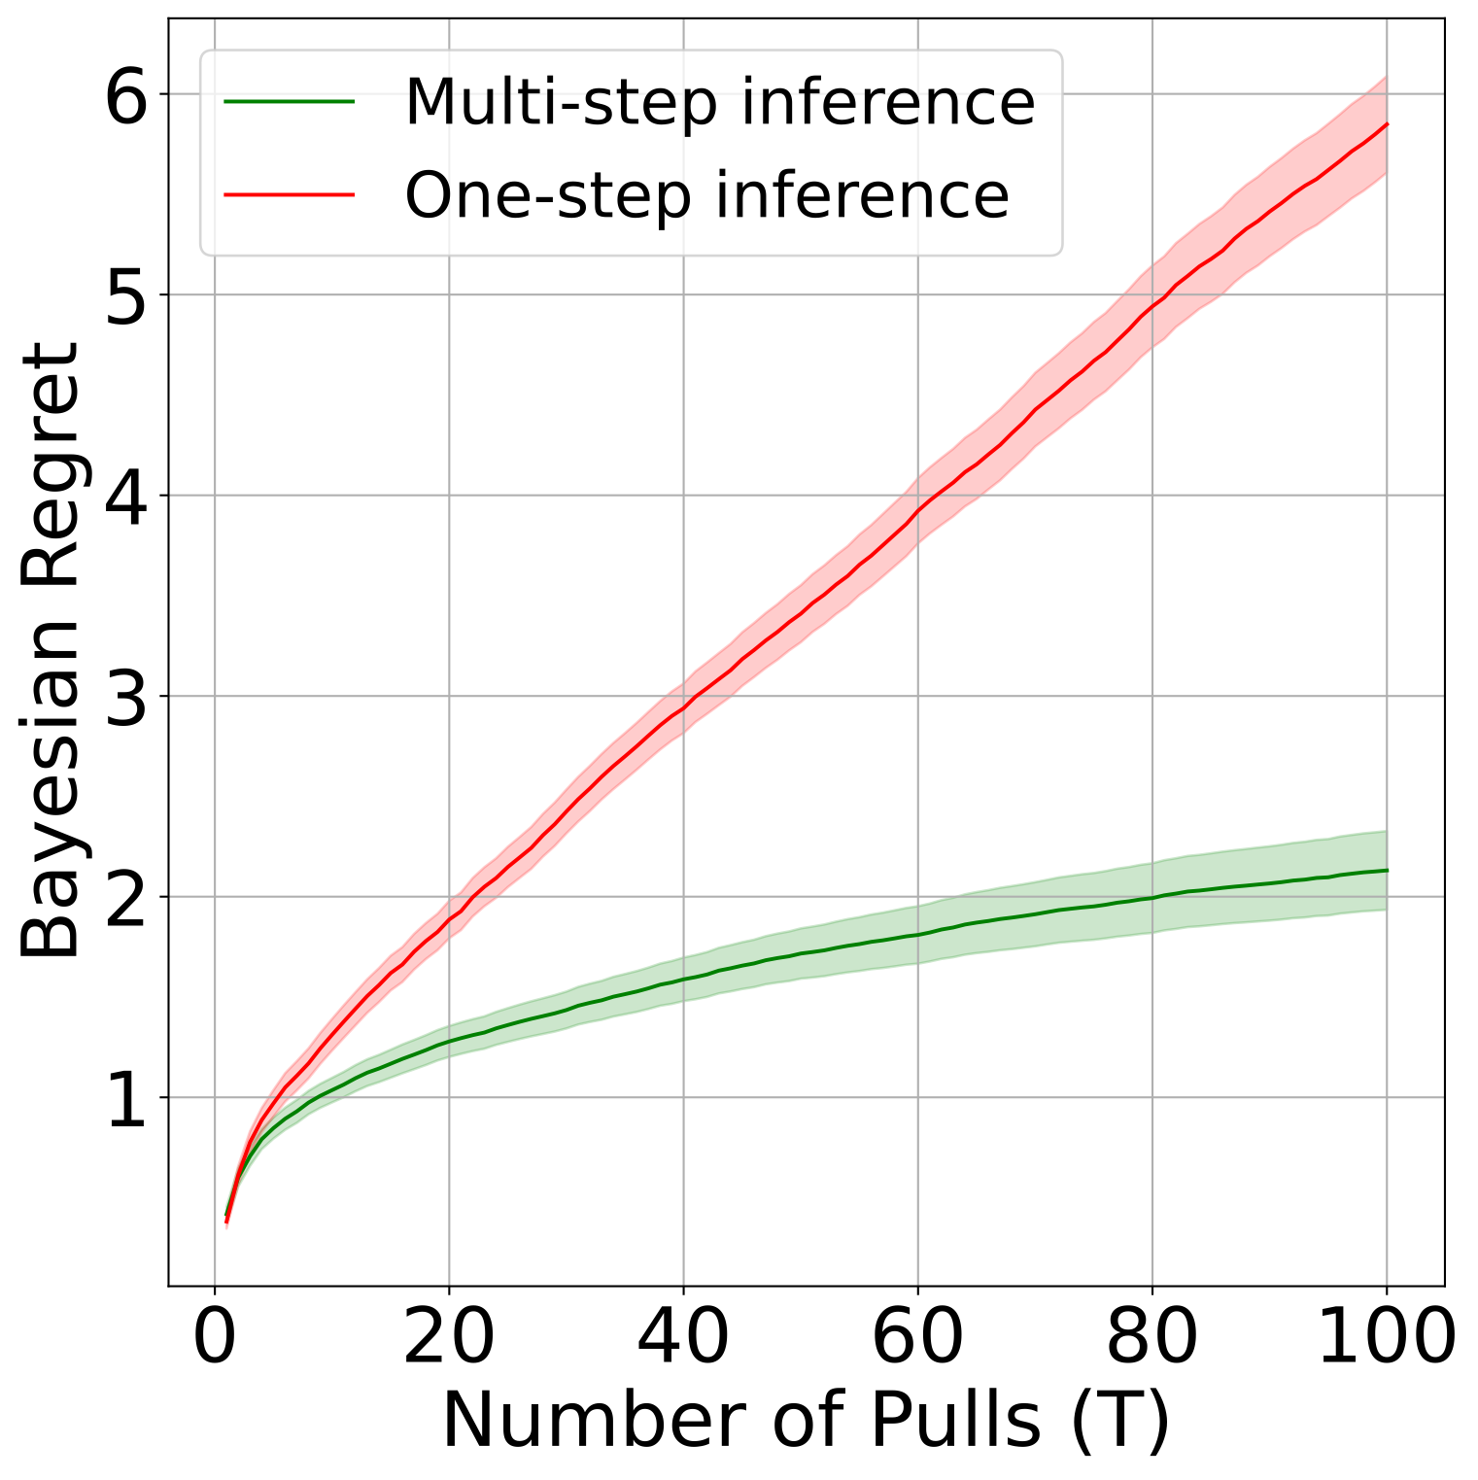
Importance of autoregressive generation
Transformers-as-Bayes papers fail to isolate epistemic uncertainty
Students make mistakes / guess when they don’t know the correct answer
answer = f( question, proficiency ) + noise
Autoregressive generation is critical for distinguishing proficiency from noise
  Averaging over multiple Q&A washes out aleatoric noise (irreducible for each Q)
  Remaining correlation reflect epistemic uncertainty (reducible with data)]

